Slide 1
Security Tools – Typical Enterprise (Part 1)
Gartner Magic Quadrant reports
List of some other industry reports

Slide 2
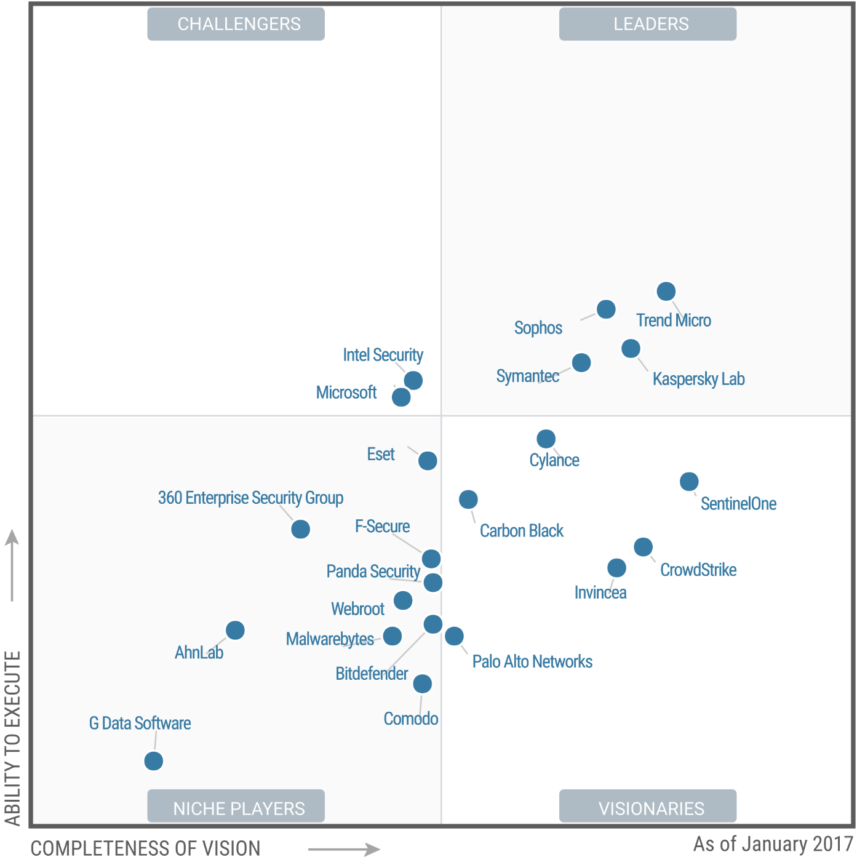
Security Tools – Typical Enterprise (Part 1)
Endpoint
Protection
Jan, 2017
Gartner
Trend Micro
Sophos
Kaspersky
Symantec
https://www.gartner.com/doc/reprints?id=1-3SCOKCW&ct=170131&st=sb

Slide 3
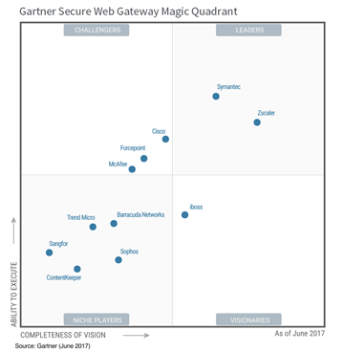
Security Tools – Typical Enterprise (Part 1)
Secure Web
GW
June, 2017
Gartner
Symantec
Zscaler
https://www.gartner.com/doc/reprints?id=1-3SCOKCW&ct=170131&st=sb

Slide 4
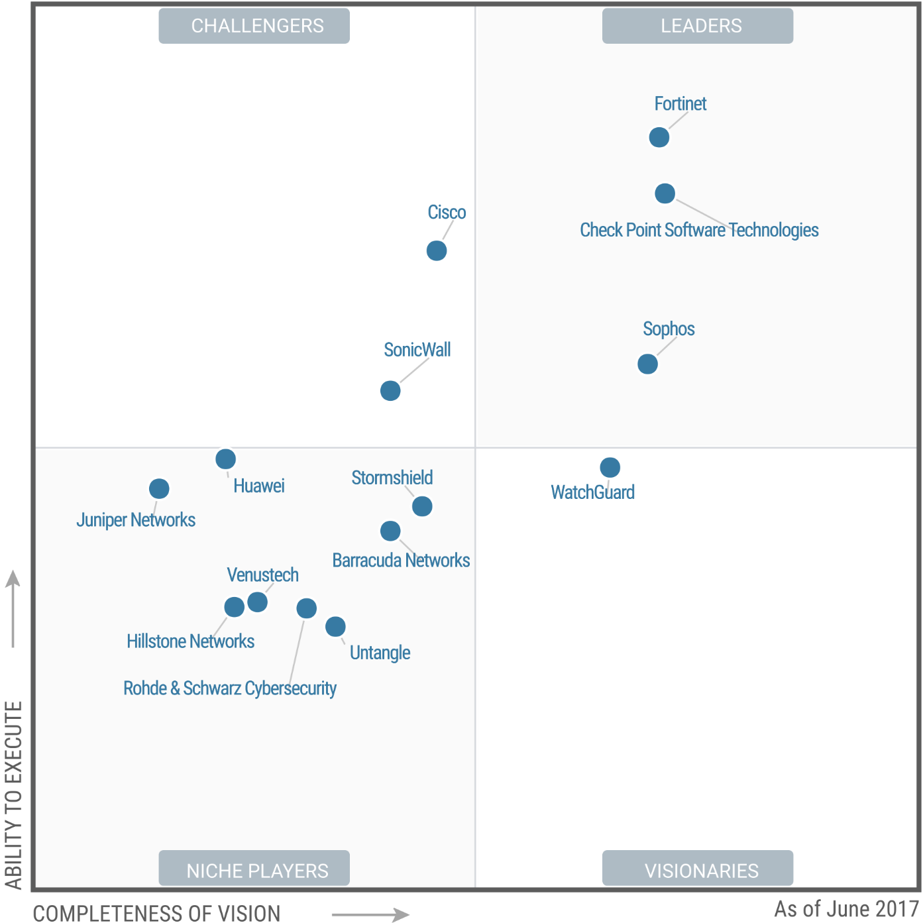
Security Tools – Typical Enterprise (Part 1)
UTM
(SMB Multi-function
FW)
June, 2017
Gartner
Fortinet
Checkpoint
https://www.gartner.com/doc/reprints?id=1-3SCOKCW&ct=170131&st=sb

Slide 5
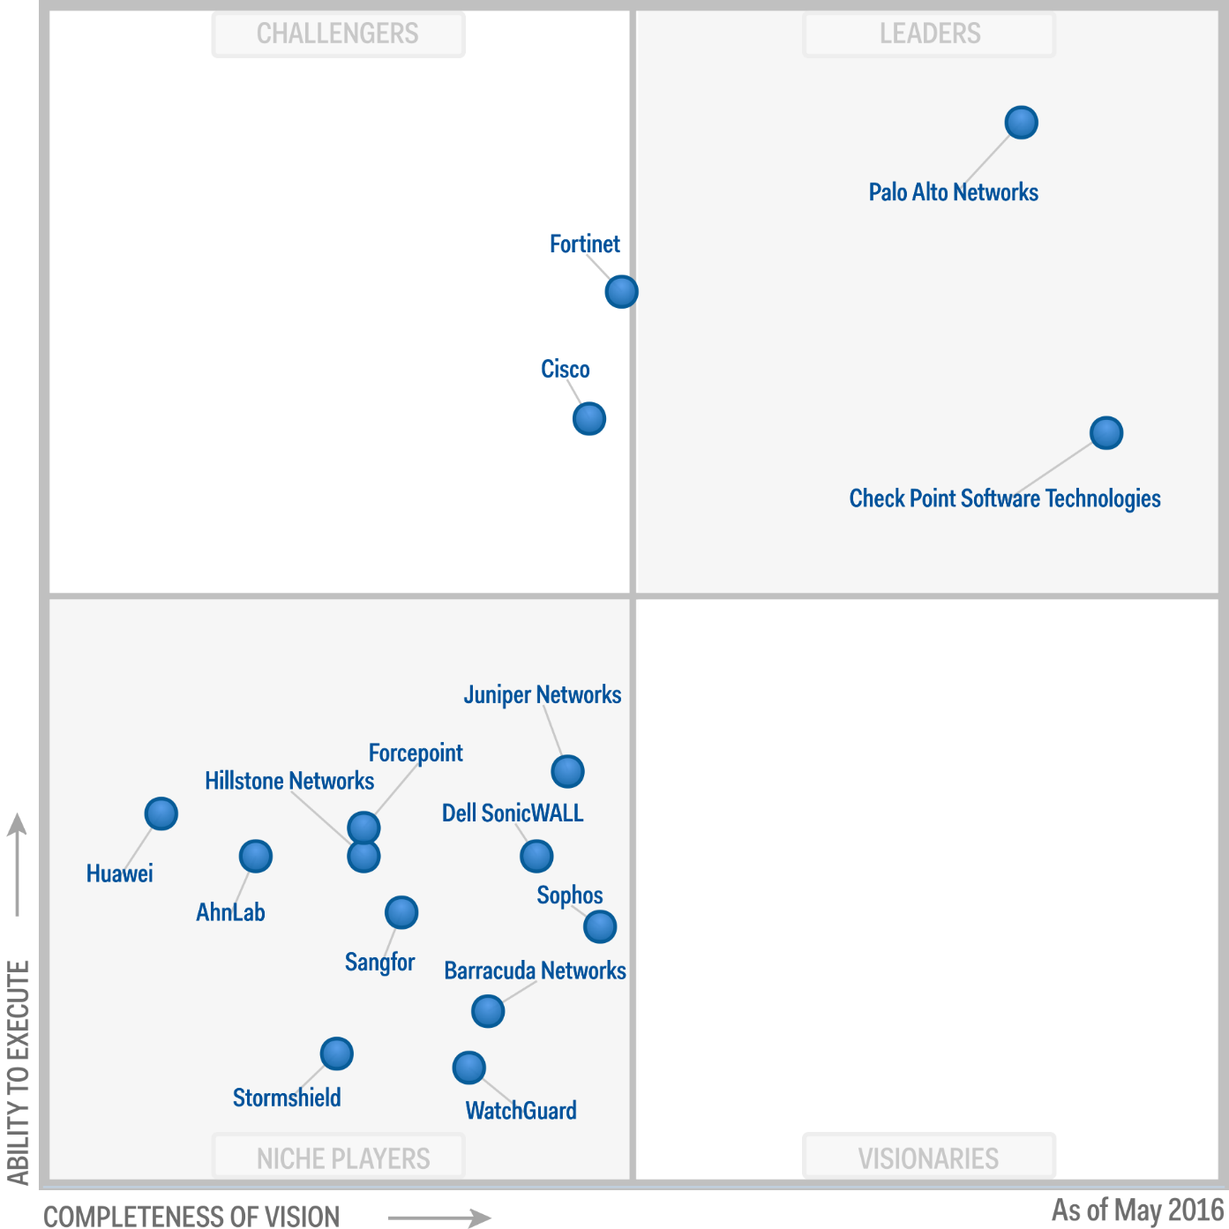
Security Tools – Typical Enterprise (Part 1)
Enterprise
Network FWs
May 2016
Gartner
Palo Alto
Networks
https://www.gartner.com/doc/reprints?id=1-3805JH8&ct=160525&st=sb

Slide 6
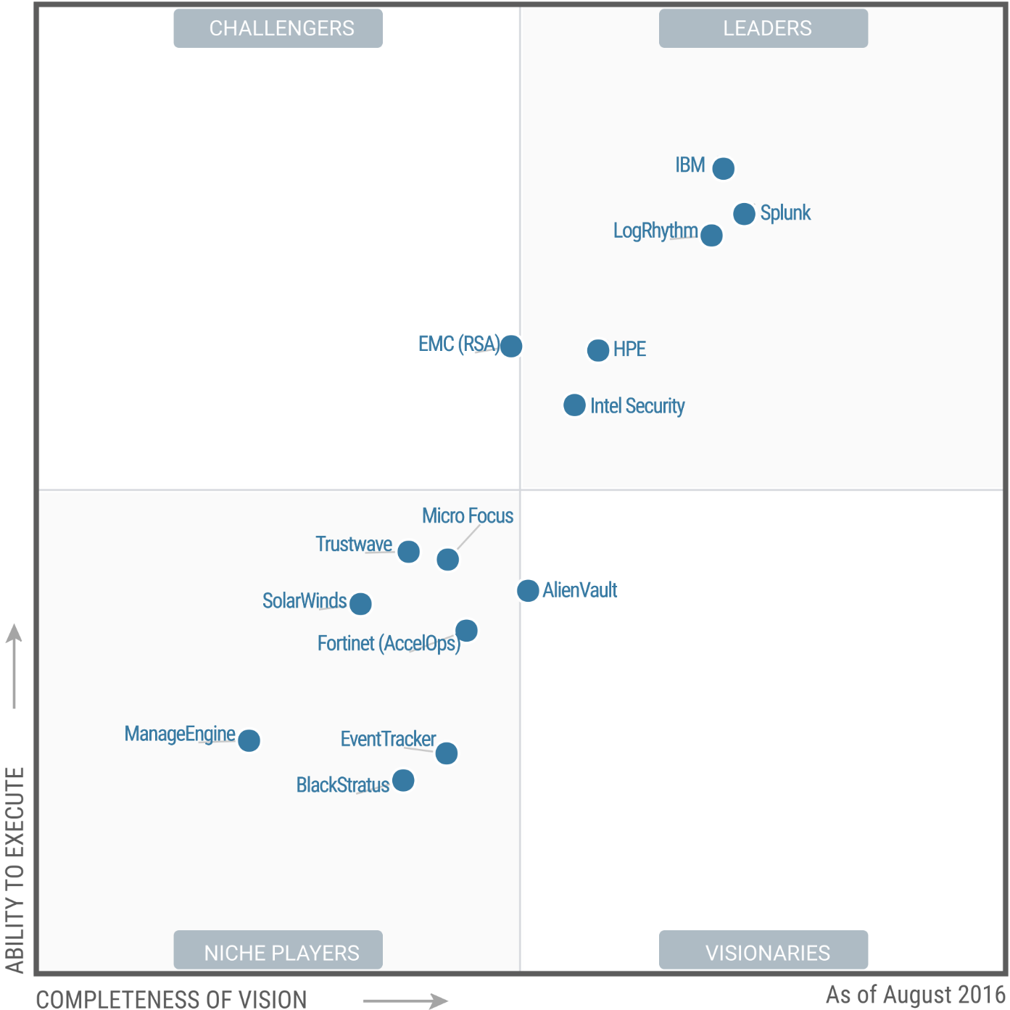
Security Tools – Typical Enterprise (Part 1)
SIEM
AUGUST 2016
GARTNER
IBM
Splunk
LogRhythm
https://www.gartner.com/doc/reprints?id=1-2JNR3RU&ct=150720&st=sb

Slide 7
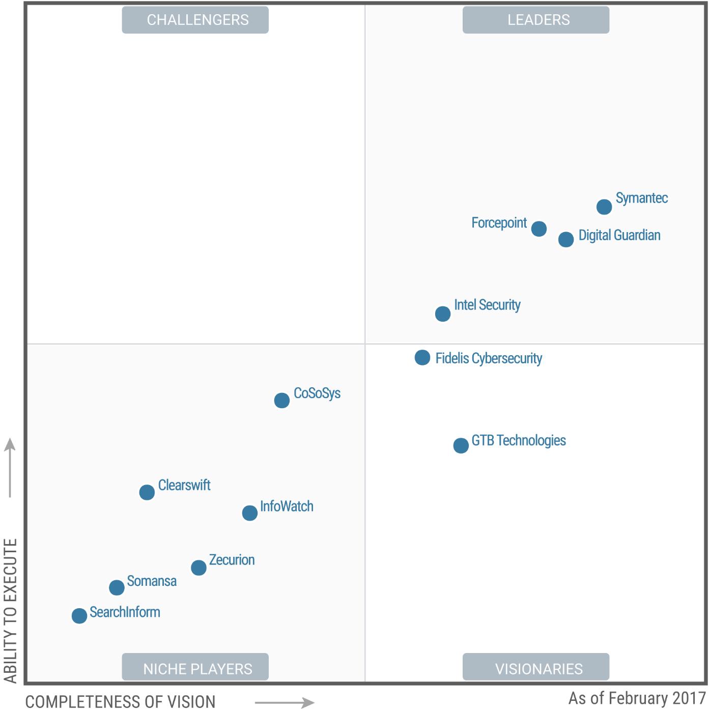
Security Tools – Typical Enterprise (Part 1)
DLP
FEB 2017
GARTNER
-Symantec
-Digital
Guardian
-Forcepoint
https://www.gartner.com/doc/reprints?id=1-3UKD88K&ct=170301&st=sb

Slide 8
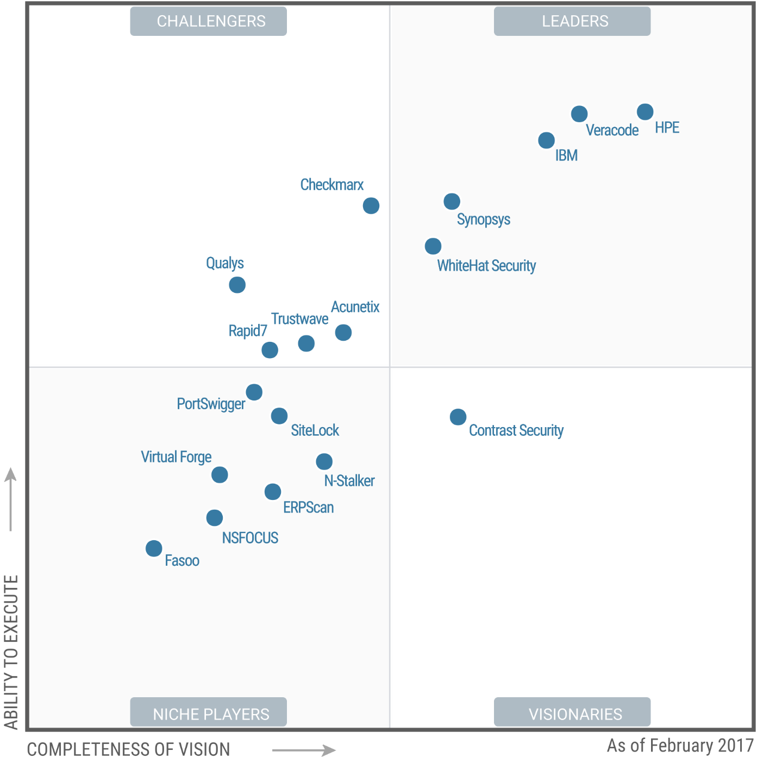
Security Tools – Typical Enterprise (Part 1)
APPLICATION
SECURITY
TESTING
FEB 2017
GARTNER
HPE
Veracode
IBM
https://www.gartner.com/doc/reprints?id=1-3UKD88K&ct=170301&st=sb

Slide 9
Security Tools – Typical Enterprise (Part 1)
View and read various industry reports for security tools comparisons:
Gartner
Forrestor
Security Awards
Lab reports: ICSA, NSS
END

